Slide 1
Career Path Presentation Christopher Madugo Pacific Gas and Electric
November 17, 2020

Slide 2
Education and Career Path
Mid Career
Pacific Gas and Electric
Ph.D. Oregon State University
Earth Consultants International
MS Central Washington University
23 Years
Geology Break
B.A. Geology
B.A. Political Science

Slide 3
Career Focus
Characterizing faults for seismic hazard assessment
Early career mostly fault location mapping, and using trenching to determine fault slip rates, timing and amount of displacement from prehistoric earthquakes
Later career focusing on deterministic and probabilistic seismic hazard assessment for utility infrastructure
I like projects at the intersection of consulting work and research

Slide 4
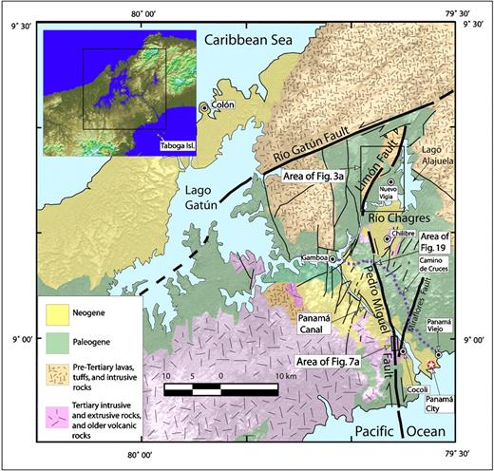
Favorite Project: Panama Canal Expansion
Fault characterization to aid in seismic design of the Panama Canal expansion.
Multi-year project involving desktop and field mapping, paleoseismic trenching to constrain fault activity and displacement per event
Study found that there are many active faults in the vicinity of the canal, including the Pedro Miguel fault, which has had three large earthquakes in the last 1600 years, with >2.1 m displacement near the canal.
Rockwell et al., 2010

Slide 5
PG&E Geosciences Department
In-house group of 20 Integrated Geoscience Experts
- Geologists
- Geotechnical Engineers
- Geophysicists/Seismologists
- Civil/Structural Engineers
Formed to Manage Long Term Seismic Program for Diablo Canyon Power Plant; an Operating License Commitment
Broadened Role Over Time to Support All Company Lines of Business for Range of Geosciences Issues
2016-2017 Storm Response

Slide 6
Infrastructure Sensitive to Geohazards
Facilities
Nuclear
Hydro
Gas storage
Other critical facilities
Linear Infrastructure
Water conveyance
Electric transmission/distribution
Gas transmission/distribution

Slide 7
Duties (what I did yesterday)
Memo on maximum credible earthquake selection for a transmission tower upgrade
Meeting to review proposals for 2021 pipeline fault crossing studies in the Eastern California Shear Zone
Meeting to review results of regional InSAR monitoring of landslides near gas transmission lines
Meeting to discuss scope and schedule to develop an update to our seismic source model for NE California
Map for a sensitivity analysis to determine the impact of spatial variations in the use of ground motion prediction equations for normal fault earthquakes
Review of a proposal for a workshop to standard post earthquake mapping and data collection based on lessons learned from recent earthquakes
Review of structural complexity mapping for a new fault displacement hazard analysis model
Research on a potentially active fault near a gas transmission line

Slide 8
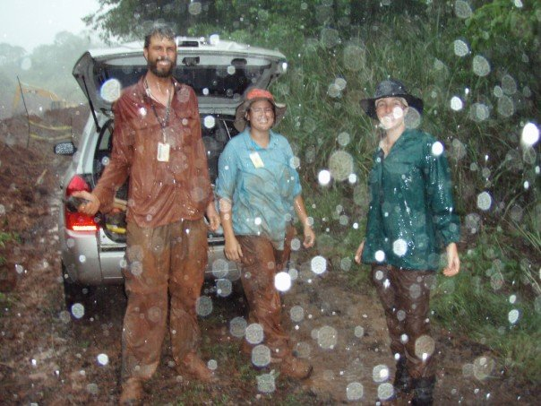
Lessons Learned
Pacific Gas and Electric
Ph.D. Oregon State University
Earth Consultants International
MS Central Washington University
Geology Break
B.A. Geology
Attitude
B.A. Political Science
Resilience

Slide 9
Pacific Gas and Electric
Ph.D. Oregon State University
Earth Consultants International
MS Central Washington University
Geology Break
Experience
B.A. Geology
Attitude
B.A. Political Science
Resilience

Slide 10
Pacific Gas and Electric
Ph.D. Oregon State University
Earth Consultants International
Mentors
MS Central Washington University
Connections
Geology Break
Experience
B.A. Geology
Attitude
B.A. Political Science
Resilience

Slide 11
Pacific Gas and Electric
Ph.D. Oregon State University
Cycles
Timing (luck?)
Earth Consultants International
Mentors
MS Central Washington University
Connections
Geology Break
Experience
B.A. Geology
Attitude
B.A. Political Science
Resilience

Slide 12
Pacific Gas and Electric
Have Fun
Ph.D. Oregon State University
Cycles
Timing (luck?)
Earth Consultants International
Mentors
MS Central Washington University
Connections
Geology Break
Experience
B.A. Geology
Attitude
B.A. Political Science
Resilience

